Slide 1
World History and the West
Lecture Topic:
The French Revolution
Notes:
Did the French Revolution truly reflect “enlightened” ideals or were they simply used
by the leaders of the movement to gain further power?

Slide 2
Introduction
Much has been written about the legacy of the French Revolution.
The advance of enlightened ideals and domestic factors would propel France into 10 years of horrible war that would transform not only France, but the world.
The Revolution would also play an integral role in the development of the West.

Slide 3
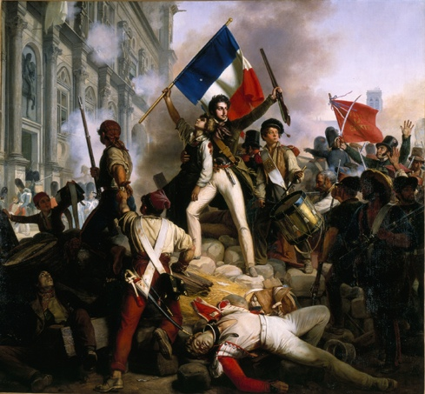
Lecture Context
Where: France
When: 1789 to 1799
Lecture Topics:
Pre-Revolution France
The Causes
Stages of the Revolution
The Legacy
Central Question:
Did the French Revolution truly reflect “enlightened” ideals or were they simply used by the leaders of the movement to gain further power?

Slide 4
The Broader Picture
The Enlightenment
The American Revolution
The French Revolution
Napoleonic Europe
Empire Building

Slide 5
Stages of the French Revolution
Moderate Stage
(1789-1792)
Radical Stage
(1792-1794)
The Directory
(1794-1799)
Napoleon Rises
(1799-1815)
The French Revolution
Napoleonic Europe
Notes:
- Most often, the French Revolution is viewed as ending with the ascent of Napoleon.

Slide 6
Pre-Revolution France
Following the reign of Louis XIV, France experienced a series of weak monarchs (Louis XV and Louis XVI).
Although well-intentioned, these monarchs contributed to rising financial debt and frustration within the class system of France.
The rigid “Estates” system left power in the hands of only a few.
Louis VXI

Slide 7
The Estates of France
France was divided up into three levels of class, or “estates.”
First Estate | Second Estate | Third Estate
0.5% of pop. Clergy Limited taxation Church owned vast territories of land. | 1.5% of pop. Nobility Right to carry arms. No military service required. Limited Taxation | 98% of pop. Comprised everyone else. Variety of people, and professions. High taxes
Notes:
The traditional divisions of classes with the monarch at the top is known as the “Ancient Regime” (ancien regime). Those at the top had privileges.
Lawyers, doctors, shop owners, skilled and unskilled workers all made up the 3rd Estate, included peasants.
Bourgeois - those who lived in urban areas and had wealth. Often seen as the upper middle class. This term would change meaning overtime (eg. Marx).

Slide 8
Causes of the Revolution
The causes of the French Revolution developed well in advance and were diverse in nature.
The Enlightenment
The American Revolution
The Estates System
Poor Leadership and Rising Debt
Increasing Hardships

Slide 9
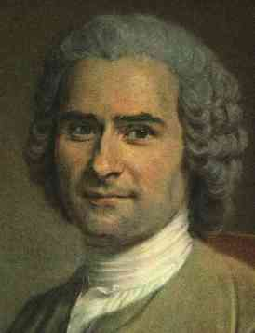
Cause #1: The Enlightenment
The ideas of the Enlightenment had especially taken root in France.
A second wave of “enlightened” thinkers furthered new ideas on freedom and rights:
Voltaire: Specifically criticized the power of the Church using satire.
Montesquieu: Advocated for the division of power.
Rousseau: Rule by “general will” of the people. Developed the slogan, “Liberty, Equality, and Fraternity (brotherhood).”
Notes:
- These three were a part of a group of enlightened thinkers known as the “Philosophe.”
- The ideas of the Enlightenment were often discussed in the “Salons” of Paris. A salon is a room in home for entertaining guests. Women often led the way in organizing these discussions on enlightened ideals.

Slide 10
Cause #2: American Revolution
The American Revolution showed that enlightened ideals were not just theoretical but could succeed in overthrowing monarchical tyranny.
France aided the Americans in overthrowing their British monarchy. Ironically, this fueled the belief that a revolution could succeed in France.
American Declaration of Impendence
Notes:
The British were the arch enemy of the French. The French crown sent supplies and soldiers to aid the Americans. Marquis de Lafayette was a famous French general who served in America.

Slide 11
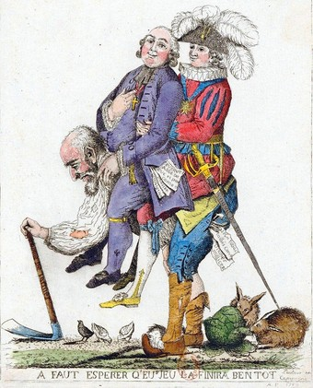
Cause #3: The Estates
Two percent of the French population made all the decisions and lived a life of privilege.
Those of the Third Estate became increasingly frustrated with their concerns not being met.
The inability to rise through the classes, and the increasing strain of taxation imposed on the Third Estate, eventually proved too much.
Notes:
The 1st and 2nd estates made up 2/3 of the Estates General (the French Parliament) and always outvoted the 3rd estate.

Slide 12
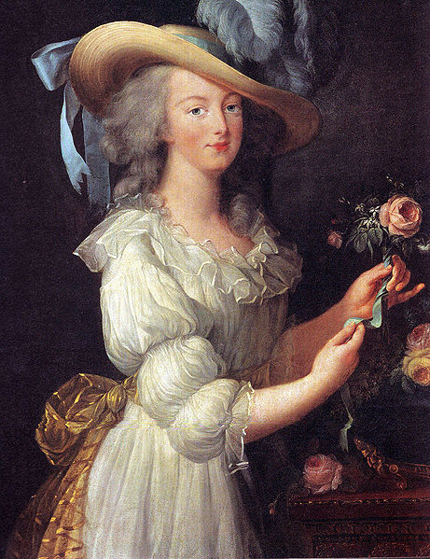
Cause #4: Leadership and Debt
Louis XIV, a very bright and capable leader, built the palace at Versailles at enormous expense.
His successors, not gifted leaders, would continue the trend in overspending and living lavishly.
National debt rose to 4 billion livres, 50% of payments on debt went to interest.
No central bank.
Marie Antoinette
Notes:
- Marie Antonette (“Madame Deficit”) would spend and spend at Versailles. Louix XVI was not a horrible person, just not a strong leader, nor did he understand the plight of the average French person.

Slide 13
Cause #5: Increasing Hardships
As debt continued to rise, new taxes and obligations would be imposed on the Third Estate.
In addition, France experienced severe winters and harvest failures from 1787 to 1788.
The cost of bread skyrocketed and the peasants, already angry, were now hungry.
The result would be the “Bread Wars.”
Notes:
- Peasants rioted as a result of the increasing cost of bread and lack of supply. This would prove to be the last spark the France needed for revolution. The people had had enough and the solutions proposed by the monarchy proved ineffective.

Slide 14
The Stages of the Revolution
There are several different stages through which the revolution progressed.
Moderate Stage
(1789-1792)
Radical Stage
(1792-1794)
The Directory
(1794-1799)
Napoleon Rises
(1799-1815)
The French Revolution
Napoleonic Europe
Notes:
The rise of Napoleon is often seen as the end of the Revolution and the beginning of the Napoleonic Era.

Slide 15
The Moderate Stage (1789-1792)
The rising crisis caused Louis XVI to re-call the Estates General (parliament) for the first time since 1615.
However, the Estates General was dominated by the 1st and 2nd Estates who controlled 2/3 of the parliament.
On June 17, 1789, the delegates of the 3rd Estate left and declared themselves the “National Assembly.”
Notes:
The votes from the 3rd Estate never mattered. The re-calling of the Estates General was purely symbolic by Louis XIV. It only served to further anger the 3rd Estate.
Members of the National Assembly declared they will not disband until the King met their demands. This became known as the “The Tennis Court Oath.”

Slide 16
The Moderate Stage (1789-1792)
On July 14, 1789, the “Bastille” of Paris was stormed. The historic prison was occupied, prisoners freed, and then torn down brick by brick.
The National Assembly created the “Declaration of the Rights of Man” and also voted to abolish noble privileges:
Compulsory church tithes, the corvee, tax exemptions, and the estates system.
Louis XVI was now a constitutional monarch.
Storming of the Bastille
Notes:
A constitutional monarch has his/her powers limited by what is prescribed in the constitution.
In is interesting to note that at this time, Jews were be granted citizenship, and slavery abolished. It would later be brought back under Napoleon.

Slide 17
The Radical Stage (1792-1794)
The Assembly was dominated by 2 factions: the Girondins and the Jacobins.
What to do with the King and Queen? Continue with a constitutional monarchy, establish a republic, or execute the monarchs?
The Girondins and Jacobins reached an agreement to declare all those who opposed the revolution as enemies.
The King and Queen were arrested.
Notes:
A third group, the constitutional monarchs, were losing power.
The Girondins saw the Revolution as universal. As something that should spread to other countries. They were not as radical as the Jacobins.
The Jacobins were the radicals led by Robespierre. They felt this was only the start of the revolution and further violence was needed to bring about more change.
Louis and Marie were transported to Paris to be overseen more closely.

Slide 18
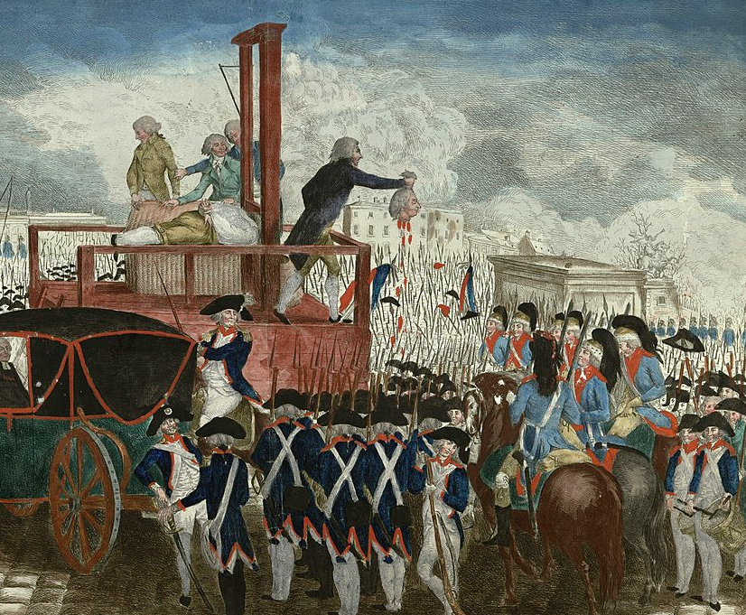
The Radical Stage (1792-1794)
The second revolution had begun, but new divisions would develop.
Battle for control of the assembly was won by the Jacobins who tried, convicted, executed Louis XVI, and Marie Antoinette.
The Jacobins, led by Maximilian Robespierre, disbanded the assembly and established the “Committee of Public Safety.”
Execution of Louis XVI
Notes:
A group of people known as the “sans-culottes” (without breeches) led the way on the streets.
Louis was executed on January 21, 1793.
The leader of the Jacobins was Maximilian Robespierre.
A new constitution would also be developed in 1792.

Slide 19
The Radical Stage (1792-1794)
“The Terror” would commence from Sept. of 1793 to June of 1794. Any opposition or suspicions of dissent would be reported and those found guilty executed by the guillotine.
City centers ran with blood as those accused were executed across France.
The revolution would finally consume itself when Robespierre himself was executed.
Maximillian Robespierre

Slide 20
The Directory (1794-1799)
This would be a time of relative stability in France led by a centrist republican government with five “directors.”
These directors were elected by parliament and power was divided between the different branches of government.
Stability, success at war, and moderation defined this era.
Napoleon also continued to rise.
Notes:
- Napoleon continues his ascent during this time. He was very successfully militarily against foreign countries, and was called upon by the Directory to suppress uprising within France itself.

Slide 21
The Rise of Napoleon (1799-1815)
One of the directors, Abbe Sieyes, began to see the need for more authoritative rule in order to further stabilize France.
Along with Napoleon’s brother, Lucien, and Napoleon himself, the three individuals staged a military “coupe d'état” to take over France.
The successful government takeover resulted in France forming an authoritarian government under “First Consul,” Napoleon Bonaparte.

Slide 22
The Legacy of the Revolution
Ten years of turmoil would transform France, Europe, and the world.
The revolution would result in much bloodshed, but also further the development of liberal democracy, equality and even nationalism.
It would set the stage for the 19th century where new ideas would transform the West.
Notes:
- Throughout this time, war with neighbouring countries continued.
- Foreign monarchs feared that revolution would also take root in their own countries, thus overthrowing monarchs across Europe and creating anarchy.
France experienced continual war with neighbour countries during the Revolution and beyond under the rule of Napoleon
Did it truly transform France and the West, or was it merely an act of revenge against absolutism that culminated in a violent transition to totalitarianism?

